Slide 1

GDELT Knowledge Base
Intelligent Retrieval & RAG Evaluation
Learning to navigate complex events with multi-strategy retrieval
[1]

Slide 2


What is GDELT?
Real‑time global record • GDELT aggregates news reports every 15 minutes, capturing events around the world from news, blogs and social media. • It records information on people, organizations, locations, themes and emotions, offering a snapshot of the world’s events. Applications • Event monitoring and crisis detection. • Risk assessment and predictive analytics. • Social science research and trend analysis.
[16]

Slide 3


GDELT KG Purpose & Use
From GKG2 to Graph • GDELT’s Global Knowledge Graph (GKG2) is stored in multiple relational tables linking events, mentions and articles. • Converting these tables into a proper knowledge graph requires an ontology that mirrors the relational schema. Limitations of Text‑Only RAG • Standard RAG pipelines using unstructured text miss global relationships embedded in the event graph. • KG‑based retrieval lets LLMs ingest relational context, enabling richer reasoning over events and actors.
A Typical Use Case for GDELT Data Leverage GDELT events and the derived knowledge graph to augment an agentic RAG system of global event data. By integrating graph‑based retrieval strategies, your pipeline captures relationships between actors, locations and themes, providing deeper context for question answering.
[17] [18]

Slide 4


Problem & Audience
Massive & heterogeneous knowledge graph
Millions of global events with varying granularity require flexible retrieval strategies.
Need for adaptable RAG pipelines
Comparing dense, sparse, hybrid & reranked retrievers helps identify optimal approaches.
Audience
AI engineers, data scientists & solution architects exploring knowledge-graph RAG pipelines.
[2] [3]

Slide 5




Solution & Technology Stack
Five-Layer Architecture Execution: LangGraph server, ingestion & evaluation scripts Orchestration: LangGraph workflows & state management Retrieval: Factory of Naive, BM25, Ensemble & Cohere Rerank Data: Qdrant vector store & HF datasets (38 docs, 12 QA pairs) Config & External: GPT‑4.1 LLM, text-embedding-3-small, Cohere rerank v3.5
Vector Store
Qdrant (Docker)
LLM
OpenAI gpt‑4.1-mini
Embeddings
OpenAI text‑embedding-3-small
Reranker
Cohere
[4] [5]

Slide 6

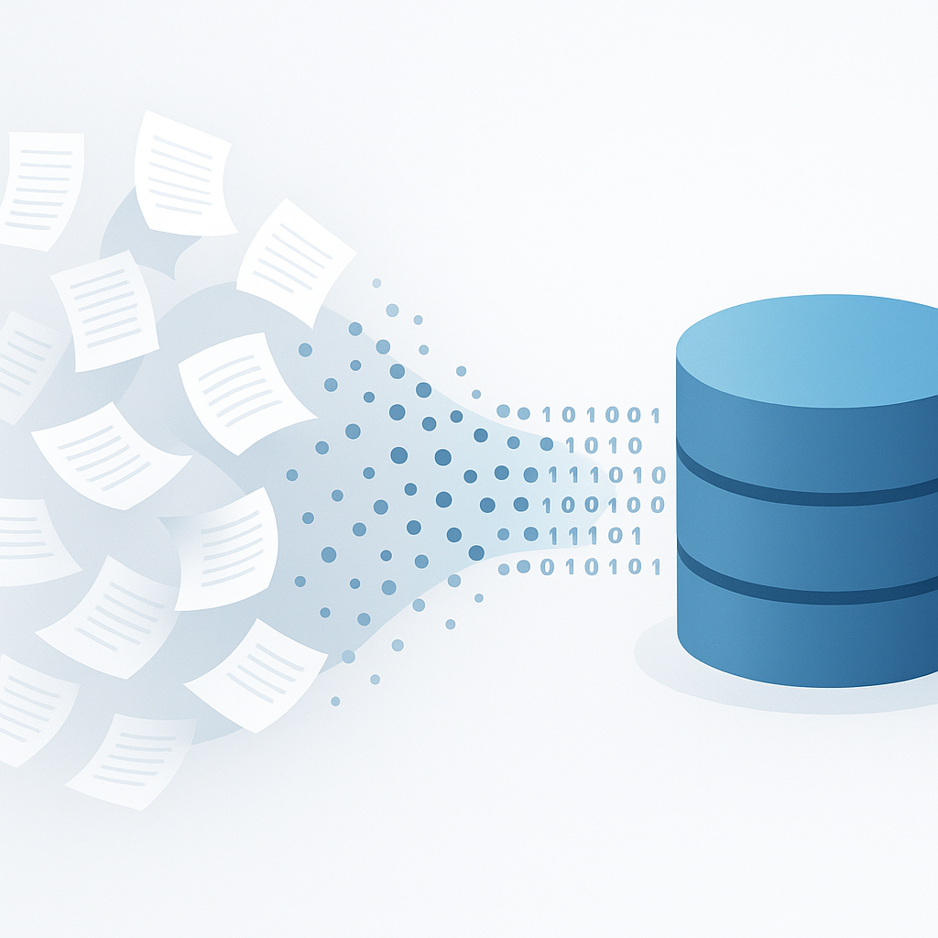



Data Ingestion & Preparation
12‑page PDF Raw GDELT paper
38 Documents Page‑level chunks
HF Datasets Sources & testset
12 QA Pairs Synthetic evaluation set
[6] [7]

Slide 7
Layered Architecture
Execution Ingestion & evaluation scripts, LangGraph Platform server, LangChain Document loaders
Orchestration LangGraph builders & state schemas
Retrieval Factory: Naive, BM25, Ensemble, Cohere Rerank
Data Qdrant store, HF datasets & manifest
Config & External LLM, embeddings, reranker & environment
[8] [9]

Slide 8

Retrieval Strategies & Factory Pattern
Strategy | Approach | Details
Naive | Dense vector search | Embeddings + cosine similarity (k=5)
BM25 | Sparse keyword | TF‑IDF & in‑memory index (k=5)
Ensemble | Hybrid 50/50 | Weighted merge of dense & sparse
Cohere Rerank | Contextual compression | Wide retrieval (k=20) → rerank top‑3
Factory Pattern Example
def create_retrievers(documents, vector_store, k=5):
return {
"naive": vector_store.as_retriever(search_kwargs={"k": k}),
"bm25": BM25Retriever.from_documents(documents, k=k),
"ensemble": EnsembleRetriever(
retrievers
=[vector_store.as_retriever(search_kwargs={"k": k}), BM25Retriever.from_documents(documents, k=k)],
weights
=[0.5, 0.5],
),
"cohere_rerank": ContextualCompressionRetriever(
base_retriever
=vector_store.as_retriever(search_kwargs={"k": 20}),
compressor
=CohereRerankCompressor(model="rerank-v3.5", top_n=3),
),
}
[10] [11]

Slide 9



Evaluation Pipeline & Metrics
Data Loading Load source docs & golden test set from HuggingFace
Build RAG Stack Vector store → retrievers → graphs
Inference Run 12 questions across 4 retrievers
Evaluation Compute four RAGAS metrics per run
Analysis Aggregate scores & rank strategies
[12] [13]

Slide 10


Performance & Next Steps
Naive
0.926
BM25
0.932
Ensemble
0.923
Cohere Rerank
0.944
Findings • Cohere Rerank achieves the highest average due to enhanced context precision. • BM25 improves precision over Naive but slightly lowers answer relevancy. • Ensemble balances dense & sparse but does not surpass extremes. Next Steps • Dynamic weighting & meta-learning to adapt retrieval strategy per query. • Graph-based retrieval exploiting event relations for deeper context. • Integrate graph neural rankers & cross-lingual embeddings. • Evaluate on additional domains to stress‑test generalisability.
[14]

Slide 11
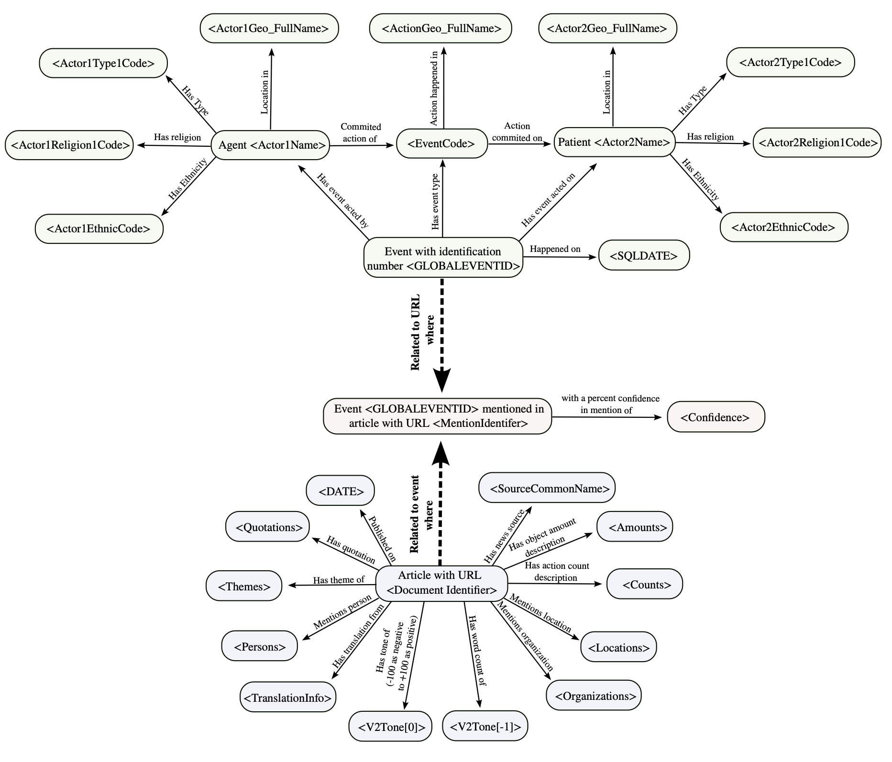
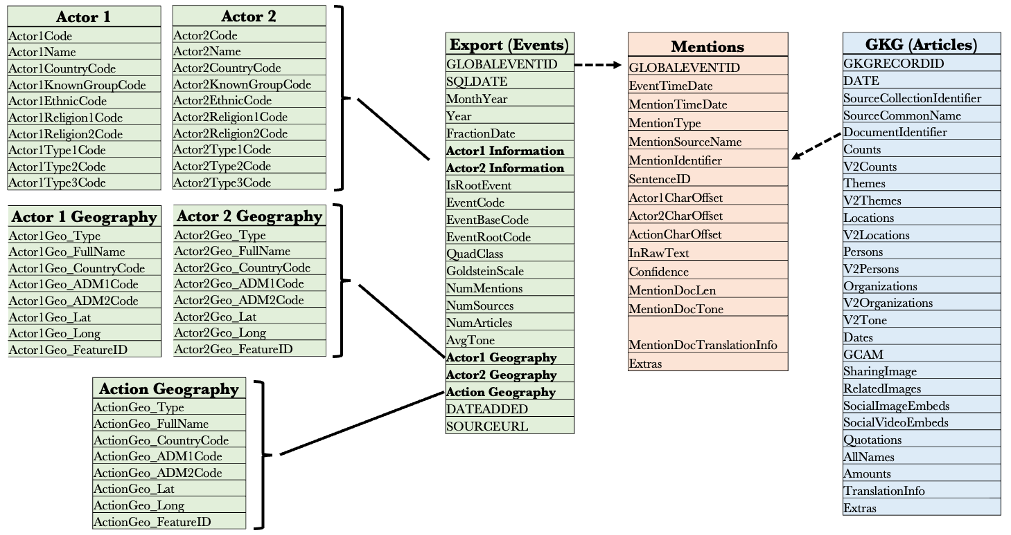
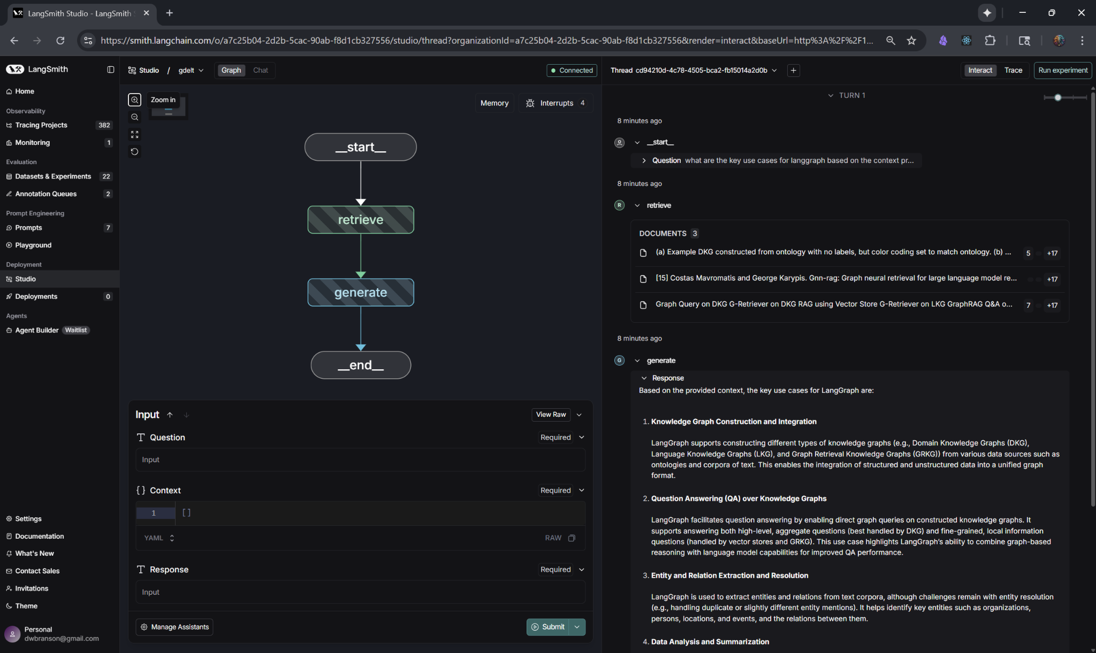
Anchors & Transparency
Ontology (not integrated currently) Mapping relational tables to entities & relationships enables KG‑based retrieval with richer context.
Schema (not integrated currently) Relational structure of actors, events, geographies, mentions & articles forms the basis for graph conversion.
Interactive UI LangGraph Studio visualises retrieval pipelines and encourages experimentation via chat and live panels.
Datasets: sources | testset | eval metrics | eval inputs
Reproducible workflow:
make process executes modular steps; manifests track provenance & checksums, ensuring transparency. Explore metrics in the interactive Hugging Face Datasets SQL console.
[19] [20]

Slide 12
Conclusions & Reflections
Key Takeaways • Multi‑layer architecture promotes modularity & separation of concerns. • Retriever factory enables experimentation & easy comparison of dense, sparse, hybrid & reranked methods. • RAGAS metrics (faithfulness, answer relevancy, context precision & recall) provide holistic evaluation. • Manifest-driven reproducibility ensures deterministic results & data lineage. Reflection This study showcases a production-grade RAG system built atop GDELT documentation and papers. The architecture and evaluation methodologies can generalise to learning how to more effectively use other knowledge graphs, fostering rigorous experimentation and observability. Future work may explore Semantic Chunking, Parent Document retrieval methods, GraphRAG techniques, dynamic retrieval selection and broader multi-lingual datasets.
For a deeper dive:
deliverables
architecture
Teaching Claude Code how to `make` it from scratch
GDELT papers and documentation
[15]

